Slide 1




Towards IP-based Geolocation via Fine-grained and Stable
Webcam Landmarks
2021/12/18

Slide 2
01
Abstract
GeoCAM：
automatically generate qualified landmarks from online webcams, providing IP-based geolocation services with high accuracy and wide coverage.
GeoCAM periodically monitors websites that are hosting live webcams and uses the natural language processing technique to extract the IP addresses and latitude/longitudeof webcams for generating landmarks at large-scale.

Slide 3
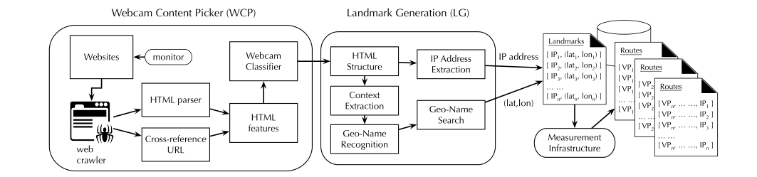
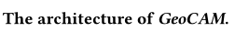
02
Architecture

Slide 4
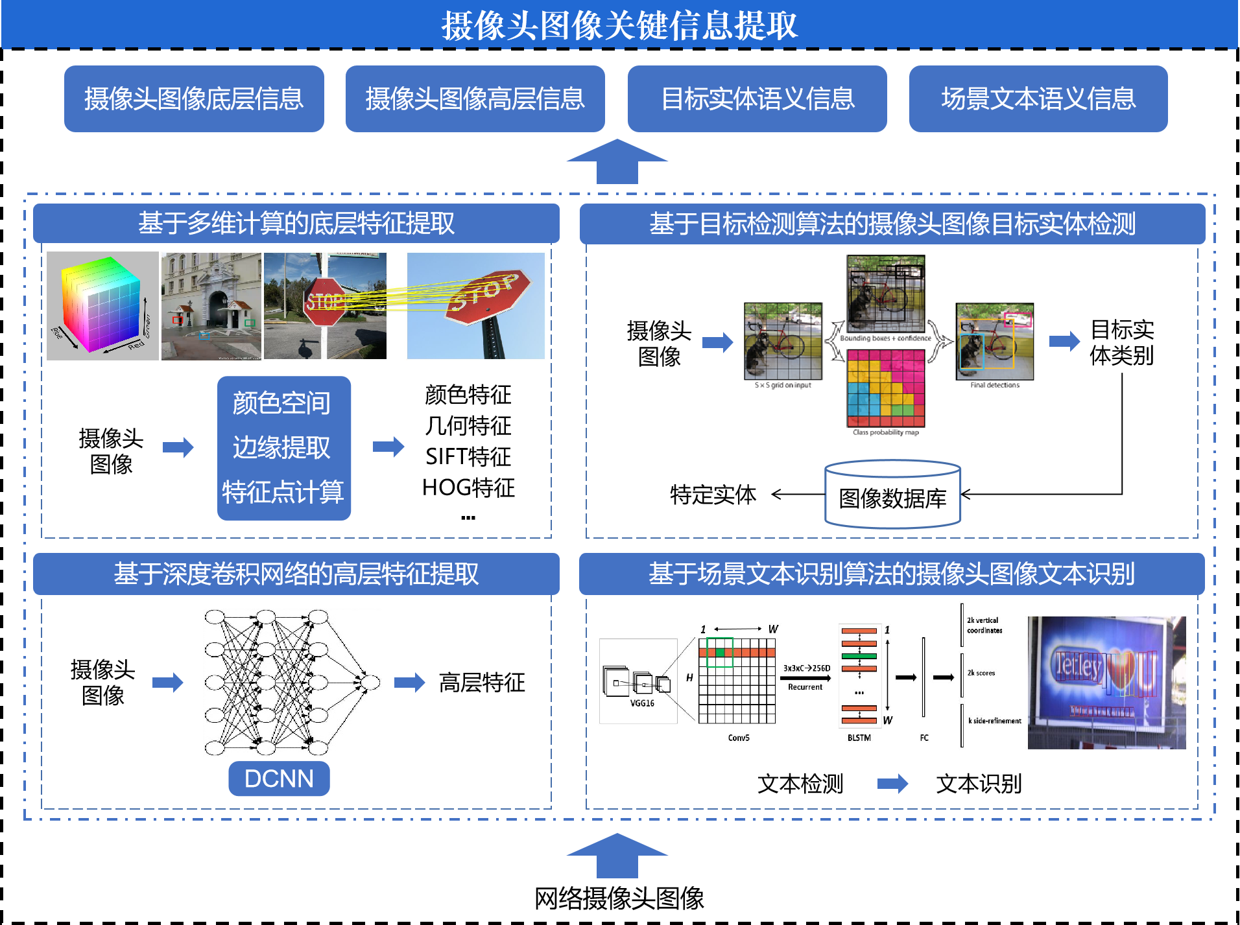
03
国防科大项目调研

